Slide 1
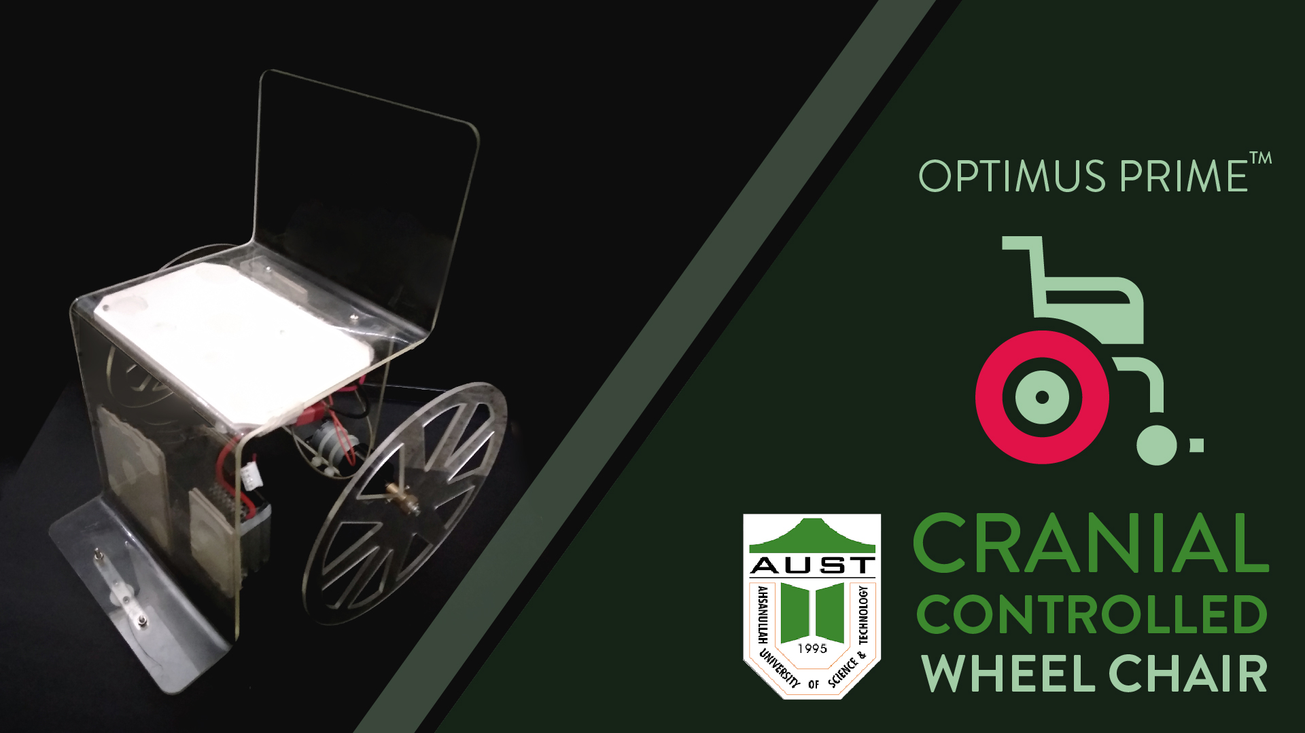

Slide 2

According WHO About 15% of the world's population lives with some form of disability. People with disabilities were shown by the World Bank to comprise 15 to 20 percent of the poorest individuals in developing countries. World Bank estimated, At least 80% of humanity lives on less than $10 a day.
Survey

Slide 3
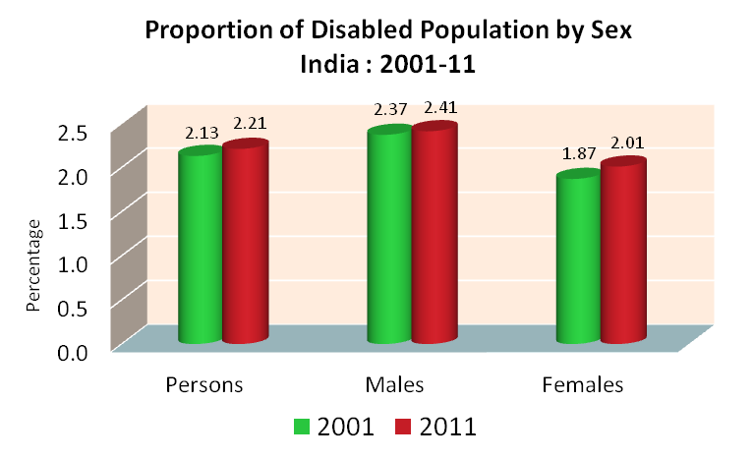
India’s Census of 2011 has revealed that over 26 million people in India as suffering from one or the other kind of disability which is 2.21% of total population.

Slide 4
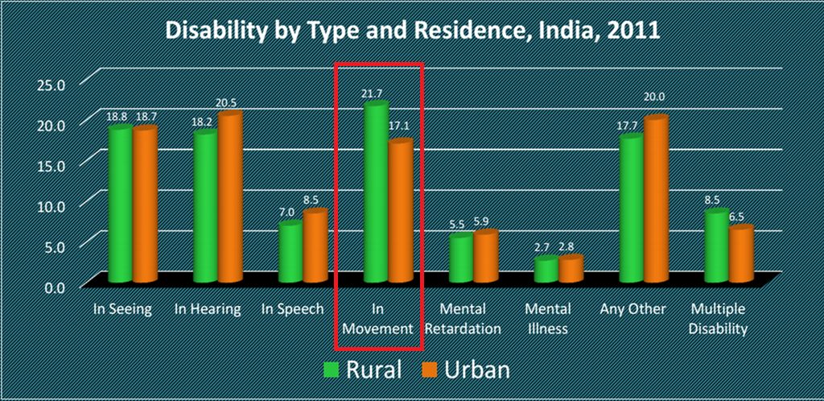
In India, 21.7% (7 million) of the disabled persons are having disability in movement.

Slide 5


Here , India has 22.3% of people below poverty line. They Earn less than $2 a day according to census of India, they are extreme poor.

Slide 6

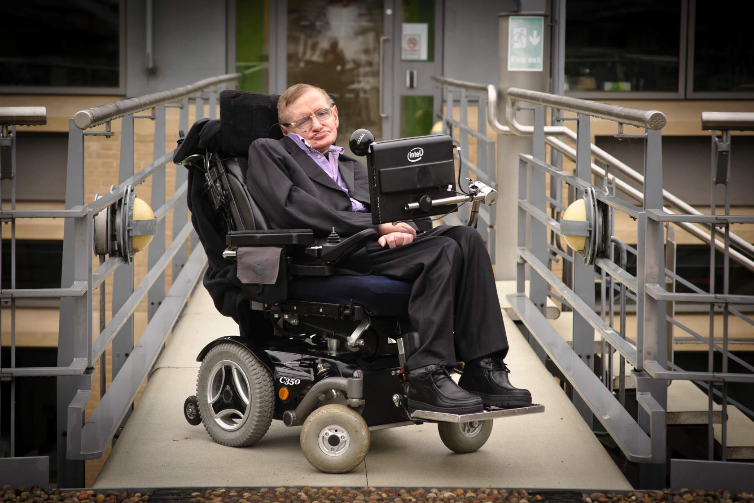
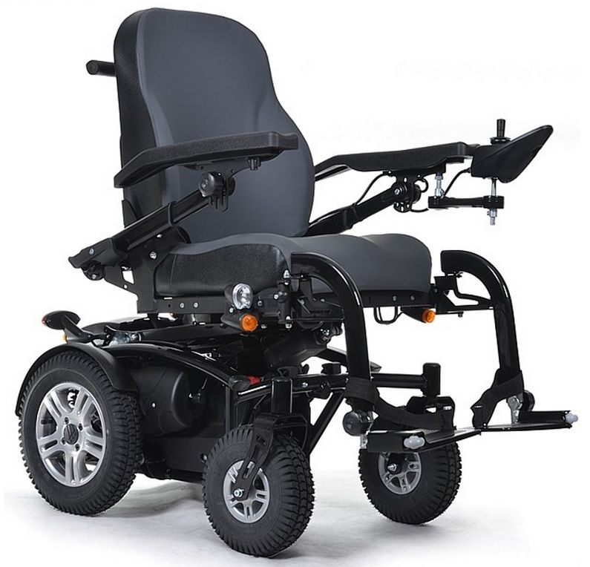
Trend
20,000$
3,000$ to 15,000$

Slide 7

Limitations
Costing
These devices cost 3,000USD to 15,000 USD.
Both Hand Disability
The Poor can not afford it.
Not for them who don’t have both hands.

Slide 8

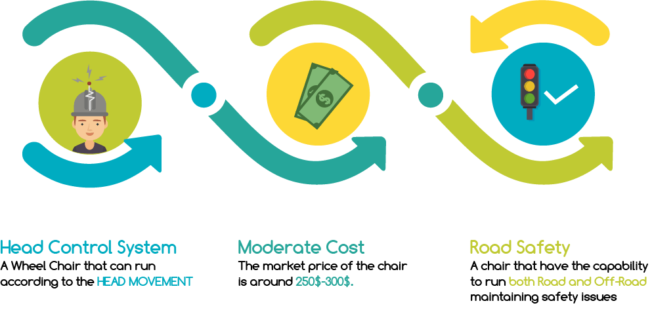
Solution

Slide 9
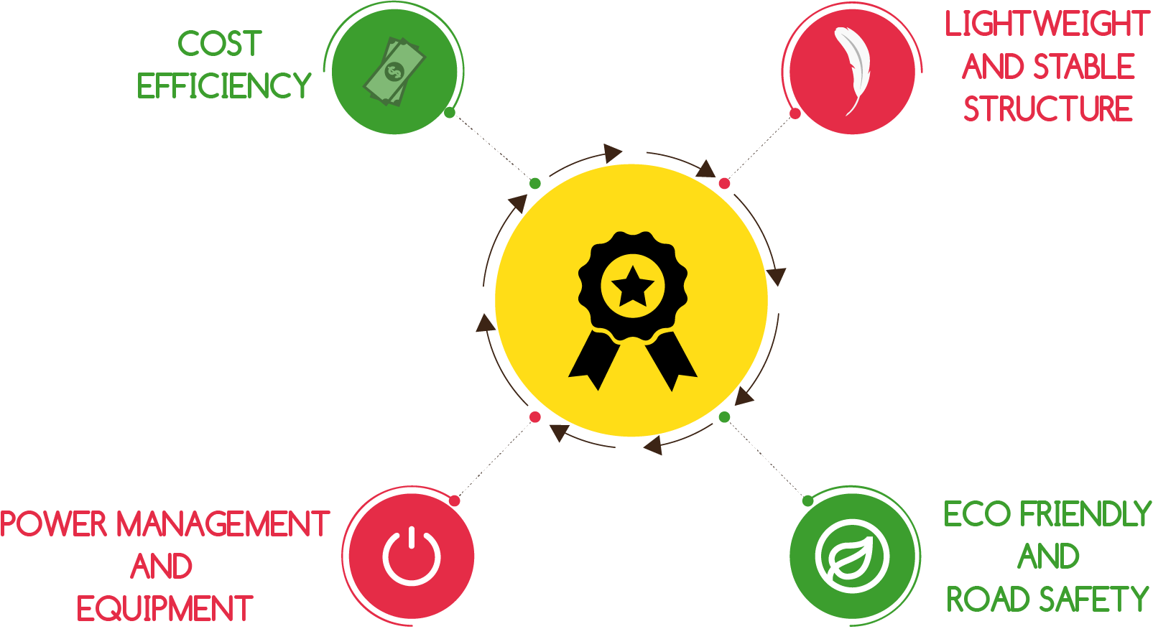
Challenges

Slide 10

Cranial Control Wheel Chair
By Using few particular components, we leap forward to create a CRANIAL CONTROL WHEEL CHAIR by solving all the challenges.

Slide 11

Prototype Video

Slide 12
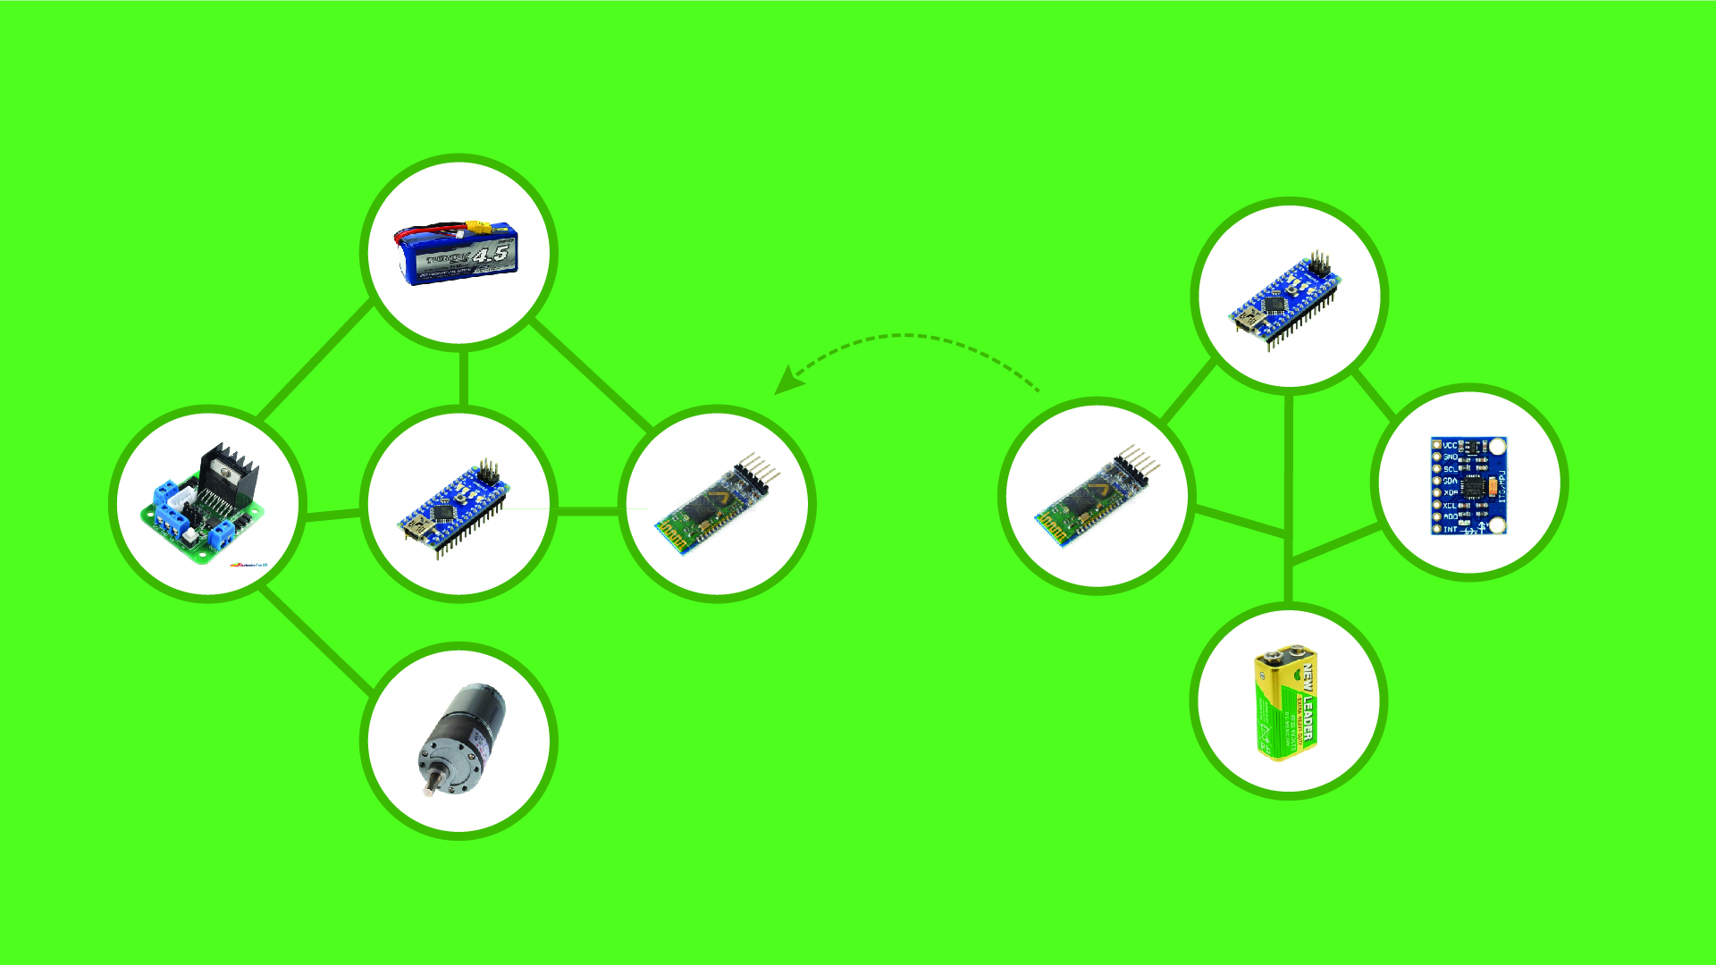
Components

Slide 13

simulation

Slide 14

Advantages
◙ Cost Efficiency.
◙ Eco Friendly and Water Proof Design.
◙ Comfortable as we will maintain India’s some renown psychologist and physiotherapist recommendation while producing it industrially.
Dr. Shweta Kumari. Dr. Shilpa Aggarwal. Dr. Philip Babu.
◙ Side viewing while riding on the road.

Slide 15

Impact
◙ Self Reliance.
◙ Confidence and Mental Stability.
◙ Participation in Social development and affairs.
◙ Bringing out the hidden aptitude.

Slide 16

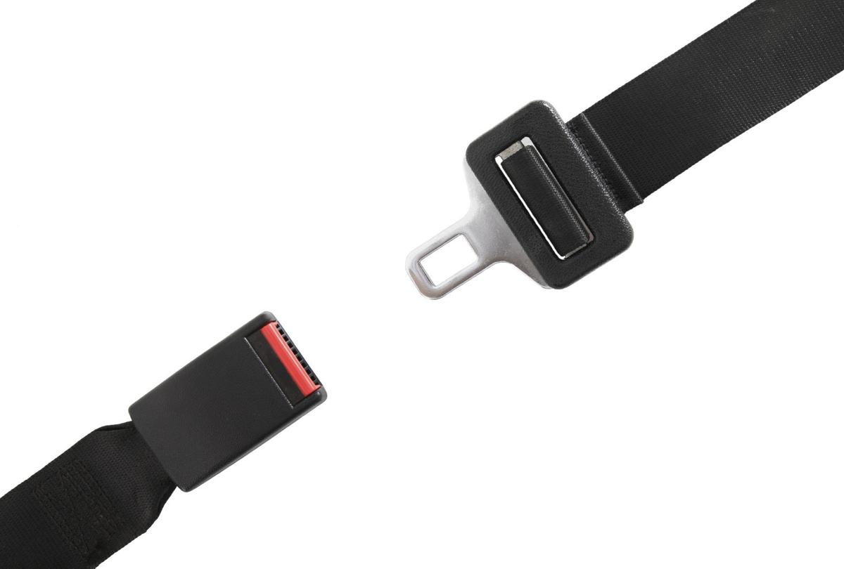
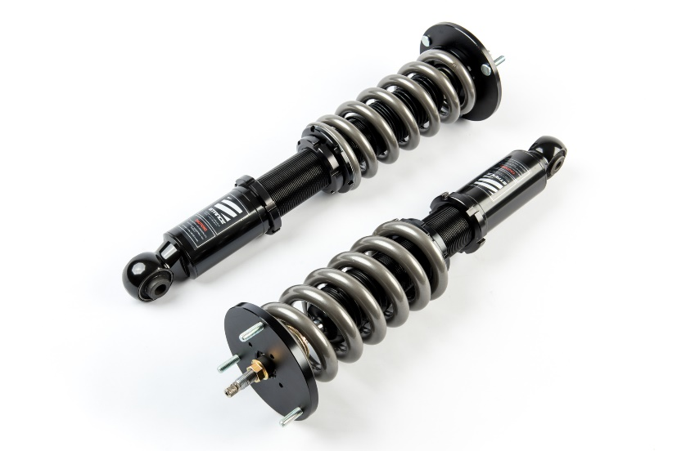
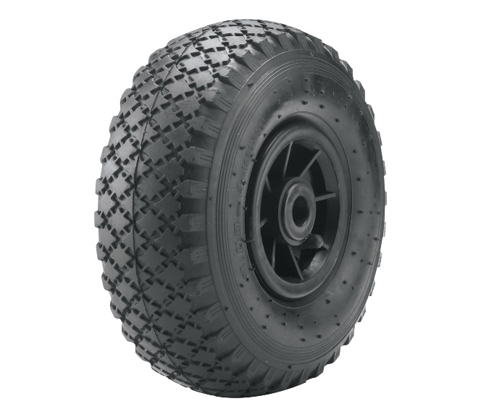
Safety and Health
◙ Seatbelt.
◙ Suspension.
◙ Emergency Brake system.
◙ Wide tires with spike.
◙ Water Proof structure.

Slide 17
Cost Breakdown
Receiver Transmitter Structure
Equipment | Price(rupee)
Arduino nano | 170
24V CSB lead acid battery | 2300
Bluetooth HC-05 | 127
BTS7960 Motor Driver Module | 119
Buck | 34
HC-SR04 Ultra-sonic sensor | 42
Capacitor | 4
MY1016 Motor 350W (2p) | 7330
Equipment | Price(rupee)
Li-ion 9v Battery | 12
Bluetooth HC-05 | 127
Arduino nano | 170
MPU 6050 | 85
Equipment | Price(rupee)
Bamboo | 850
Suspension | 1700
Jute | 255
Foam | 260
Labor cost | 600
Wheels | 3400
Others | 1700
Total = 19,285INR
(270USD)

Slide 18
Roadmap and Future Development
◙ Stairs.
◙ Charging while Riding
◙ Both Electrical and Cranial Control in one wheel chair and produce it within 400USD.
◙ Industrial Production

Slide 19
Last Words
◙ For those of you who know people with mobility issues, can you picture the increased independence that they can achieve with such a device?
◙ Let’s have a dream that in 2030, the disability in movement will no longer be a burden in the society.

Slide 20
The Team

